Slide 1







The 2019 Stack Overflow Developer Survey
KHIN ZAR NI HTUN
23 JUN 2024

Slide 2



OUTLINE
Executive Summary
Introduction
Methodology
Results
Visualization – Charts
Dashboard
Discussion
Findings & Implications
Conclusion
Appendix

Slide 3

EXECUTIVE SUMMARY
• Top programming languages in demand:
• JavaScript, HTML/CSS, SQL, Bash/Shell/PowerShell, Python
• Top database skills in demand:
• My SQL, Microsoft SQL Server, PostgreSQL, SQLite, MongoDB
• Popular platforms:
• Windows, Linux, Docker, AWS, Slack
• Popular Web Frames:
• jQuery, Angular/Angular.js, React.js, ASP.NET, Express
• Future Technology Trend:
• Python takes the third row, followed by SQL and TypeScript
• Redis and Elasticsearch also place in Top 5
• Android is in the Top 5 demanded platforms, the rest remains
• React.js takes the first row and Vue.js is the latest addition as the last

Slide 4

INTRODUCTION
• In the realm of programming and technology,
several key trends have emerged in recent years.
• These insights shed light on the evolving landscape
of programming languages, web frameworks, and
the demographics of professional developers.
• Stack Overflow conducts an inclusive survey of
individuals engaged in coding globally.
• Covering a wide array of topics from preferred
technologies to career aspirations, 2019 marks the
9th consecutive year of survey publication.
• Nearly 90,000 developers participated in the 20
minute survey in 2019 Survey.
• Let's explore some of the notable findings.

Slide 5

METHODOLOGY
Data is based on the survey conducted by Stack Overflow from January 23 to February 14 and involved 88,883 software developers from 179 countries.
Familiarization with this dataset was achieved through completing IBM labs on Coursera, which encompassed topics such as Web Scraping, Dataset Exploration, Data Wrangling, Exploratory Data Analysis, and Data Visualization
Data analysis and visualization was conducted via IBM Cognos Analytics

Slide 6
RESULTS
Python overtakes Java, becoming the 5th most preferred language with significant growth. It stands as the fastest growing major programming language
JavaScript remains the most used programming language.
jQuery is the most widely used among web frameworks, with React.js surpassing Angular in developer usage this year.
Globally, men represent approximately 90% of respondents, with higher female representation among students than professional developers in regions like the US, India, and the UK
Around 3/4 of professional developers globally hold at least a bachelor's degree, aligning with past findings.
3/4 of survey respondents in professional developer roles are under 35 years old.

Slide 7
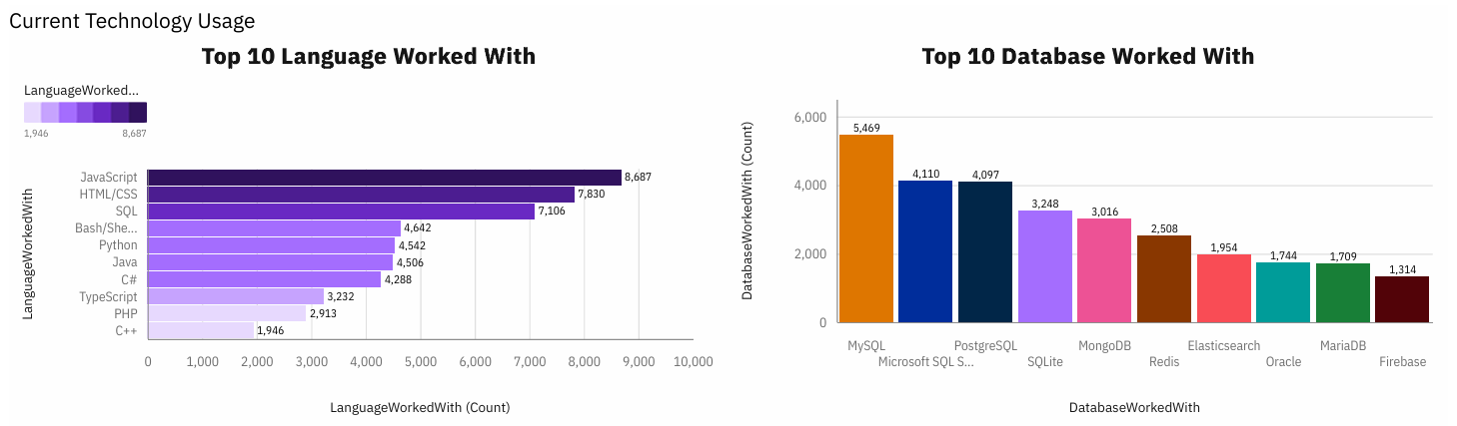
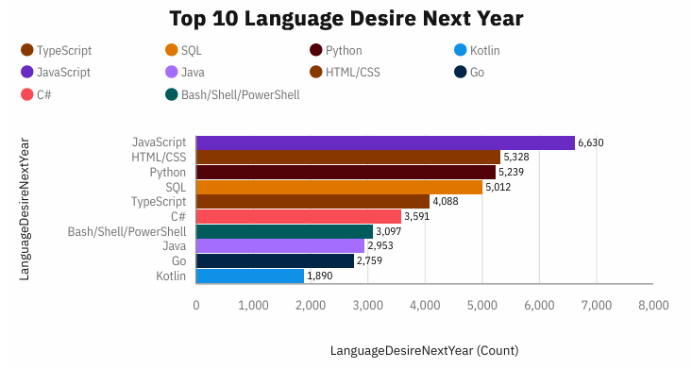
PROGRAMMING LANGUAGE TRENDS
2019
Following Year

Slide 8
PROGRAMMING LANGUAGE TRENDS – FINDINGS & IMPLICATION
FINDINGS
IMPLICATIONS
JavaScript and HTML/CSS emerge as the most used programming languages among all respondents
SQL also maintains a significant presence.
Python just edged out Java in
overall ranking
• The dominance of JavaScript and HTML/CSS
underscores their indispensability in modern
web development, highlighting the importance
of mastering them for developers.
• The high usage of SQL emphasizes the critical
role of data management and querying in
modern software applications
• The rise of Python might also reflect its
versatility and ease of use, attracting
developers across various domains from data
science to software development.

Slide 9
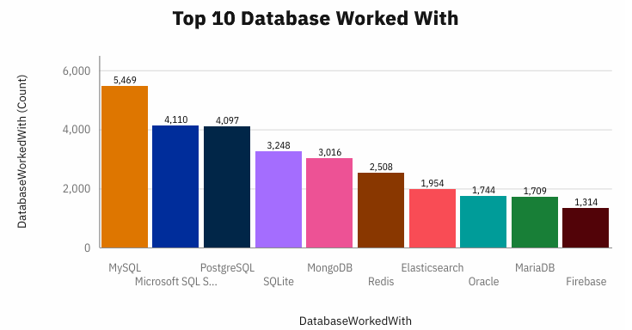
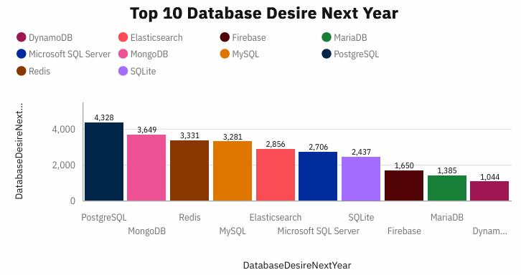
DATABASE TRENDS
2019
Next Year

Slide 10
DATABASE TRENDS - FINDINGS & IMPLICATIONS
Findings
Implications
•MySQL as most used database.
•Lack of interest in Microsoft SQL
Server and SQLite.
•Increasing interest in PostgreSQL
and MongoDB.
•Microsoft SQL Server and SQLite
losing ground in the market.
•PostgreSQL and MongoDB
establishment in the market.

Slide 11

DASHBOARD
Created my dashboard can be find out below link
https://github.com/zarnikhinkyi/Coursera-IBM-Data-Analyst-Capstone-Project/blob/main/Dashboards_on_CognosAnalyst.pdf

Slide 12
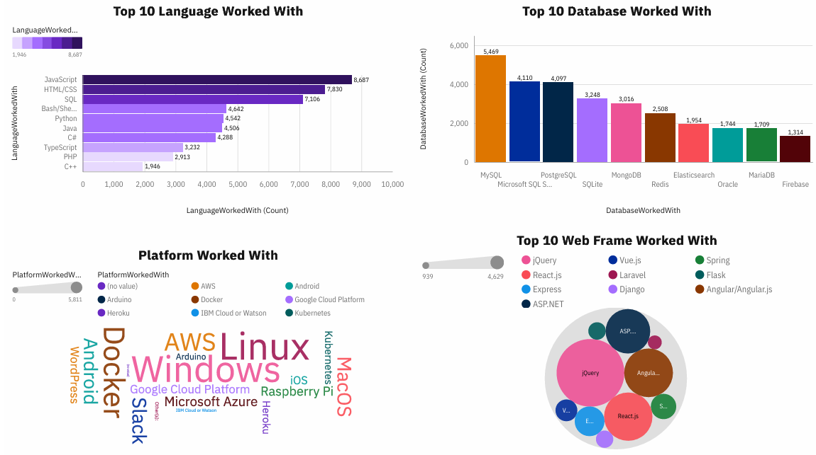
CURRENT TECHNOLOGY USAGE

Slide 13
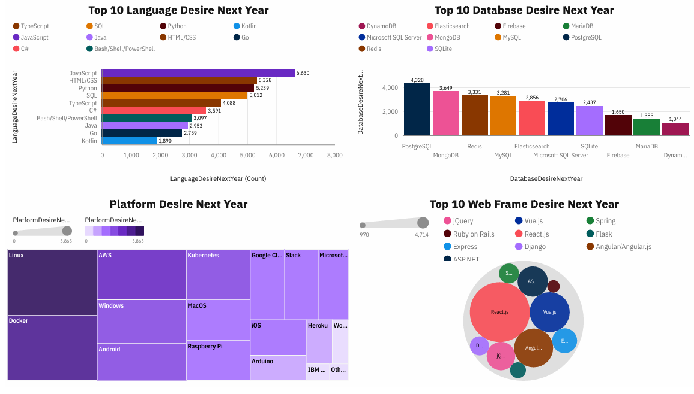
FUTURE TECHNOLOGY USAGE

Slide 14
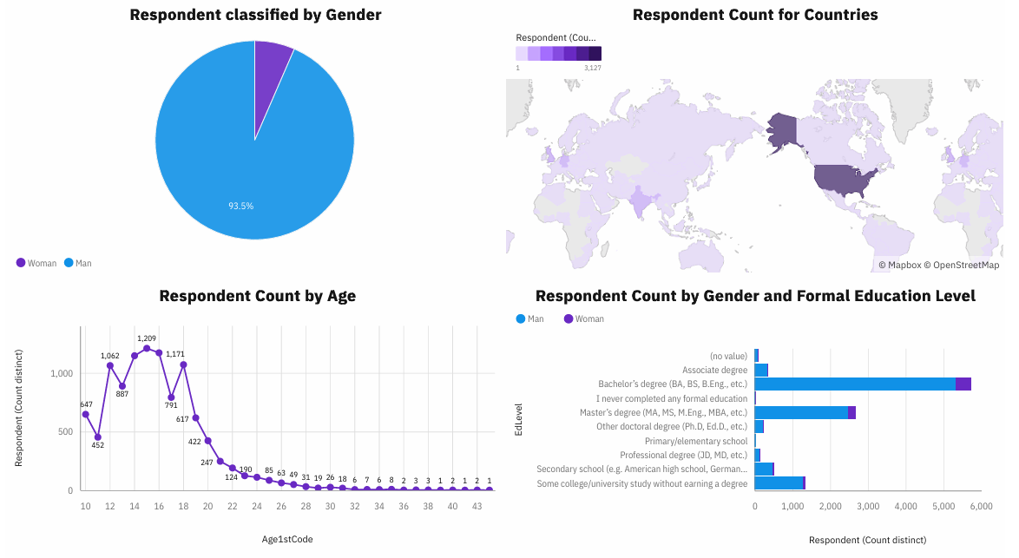
DEMOGRAPHICS

Slide 15
DISCUSSION
The dominance of JavaScript and HTML/CSS and the adoption of MySQL as the leading database management system
Highlights the central role of web development in the programming landscape
Opens up discussions on the significance of client-side scripting and styling, trends in web development frameworks, and the evolving nature of web technologies

Slide 16
OVERALL FINDINGS & IMPLICATIONS
Findings
Implications
•JavaScript widely used and TypeScript getting popular.
•Over 90% young male developers. •Developers mostly located in developed countries.
•JavaScript and TypeScript web frames gaining followers.
•Global polarization of developers location and gender.
•Young developers without postgrad studies on its majority.

Slide 17

CONCLUSION
Developers are people with very marked characteristics.
A good idea of popularity trends of different tools, platforms and languages can be obtained.
There is a job to be done to spread accessibility of this labor market to countries in development.

Slide 18

APPENDIX
Job Postings Chart
Popular Languages Chart

Slide 19
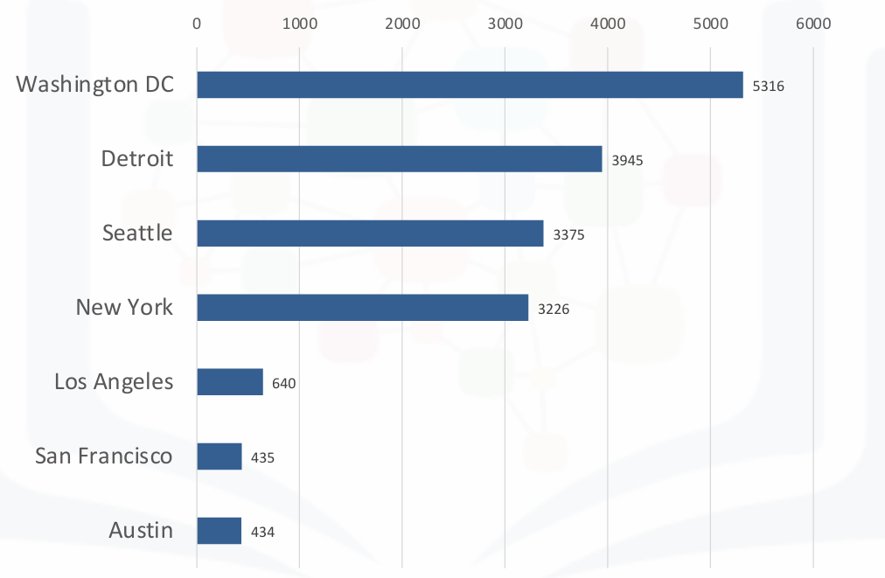
JOB POSTINGS

Slide 20
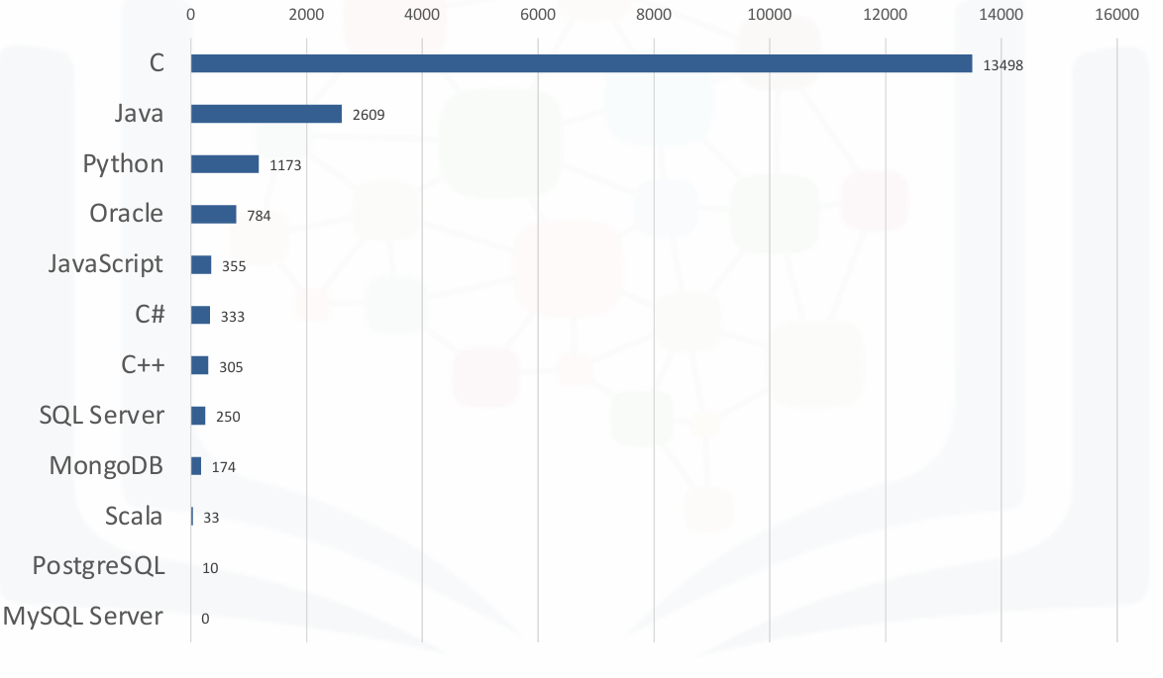
POPULAR LANGUAGES

